Slide 1
Ideation & Design Thinking

Slide 2
What is Design Thinking?
Design thinking is a mindset and approach to problem-solving and innovation anchored around human-centered design. While it can be traced back centuries—and perhaps even longer—it gained traction in the modern business world after Tim Brown, CEO and president of design company IDEO, published an article about it in the Harvard Business Review.
Design thinking is different from other innovation and ideation processes in that it’s solution-based and user-centric rather than problem-based. This means it focuses on the solution to a problem instead of the problem itself.
For example, if a team is struggling with transitioning to remote work, the design thinking methodology encourages them to consider how to increase employee engagement rather than focus on the problem (decreasing productivity).

Slide 3
4-phase version
In the online course ”Design Thinking and Innovation”, Harvard Business School Dean Srikant Datar leverages a four-phase innovation framework. The phases venture from concrete to abstract thinking and back again as the process loops, reverses, and repeats. This is an important balance because abstract thinking increases the likelihood that an idea will be novel. It’s essential, however, to anchor abstract ideas in concrete thinking to ensure the solution is valid and useful.
Here are the four phases for effective innovation and, by extension, design thinking.

Slide 4
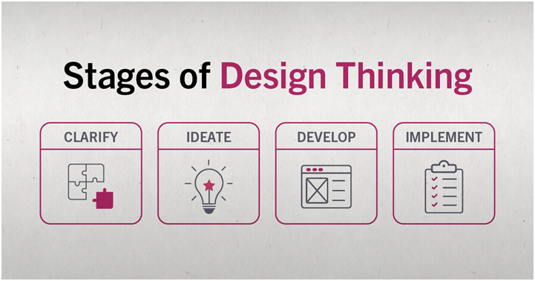
4-phase version

Slide 5
Rules of Design Thinking
Christoph Meinel and Harry Leifer of the Hasso-Plattner-Institute of Design at Stanford University (d.school) identified four rules of Design Thinking:
The human rule: design is social in nature — problems must be solved in a way that satisfies human needs and acknowledge the human elements in all technologies.
The ambiguity rule: ambiguity is inevitable — experiment at the limits of our knowledge, the limits of our ability to control events, and with the freedom to see things in a different light.
The re-design rule: all design is re-design — technology and social circumstances are constantly evolving. We need to understand how our human needs were met in the past.
The tangibility rule: making ideas tangible facilitates communication — this directly refers to creating prototypes.

Slide 6
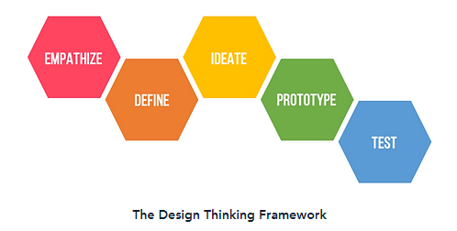
5-phase version

Slide 7
5-phase version
The 5 step process proposed by the Hasso-Plattner Institute of Design at Stanford is as follows:
1. Empathize
The empathize stage is critical to understand where the problems you are trying to solve come from. Immerse yourself into the life of your user to understand their problems. This can also be thought of as finding “gaps in the market”, where there are no straightforward product solutions to a given issue. Identify the need and address it. This phase focuses on research.
2. Define
Now that a need is identified and research is collected, you can define the problem in human-centric terms. You want this problem to be broad enough for a flexible and creative approach, but narrow enough to hone in on the problems niche.
An example of a successful human-centric problem definition could be:
“Professionals need a way to virtually take notes, mark their calendar, set reminders, and sync them for access on work and home devices to streamline organization.”

Slide 8
5-phase version
3. Ideate
Now that you understand your users problems and have analyzed your research, you can begin generating ideas to solve the defined problem.
A popular way to generate ideas is with a brainstorm. Arrange a meeting with at least four people to start off. Try to come up with as many phrases or word associations as you can — no limits, no rules! Bring in a couple individuals from other teams. People with outside experience contribute valuable ideas by looking at the problem through an alternative lens. The ideate phase focuses on free thinking and unconventional approaches.
4. Prototype
Using the best ideas from the ideate phase, you can now produce several basic iterations of your problem solving product. Early stages of the prototype phase are generally where user testing allows designers to identify kinks or missing elements of their designs. This stage focuses on experimenting by creating multiple approaches to solving the problem.

Slide 9
5-phase version
5. Test
The final stage of the design thinking process, designers now combine the best solutions from the prototype phase into one complete product. This phase involves the most user-testing.
However, the design thinking phases are not linear and the test phase is not a strict ending point. Often, testing the final product surfaces new problems and is followed by another define phase, or redirects designers to the empathy phase to work on building a deeper understanding of the user. Even if designers do not need to back track to different phases, the test phase focuses on fine-tuning the product to create the best possible solution.

Slide 10
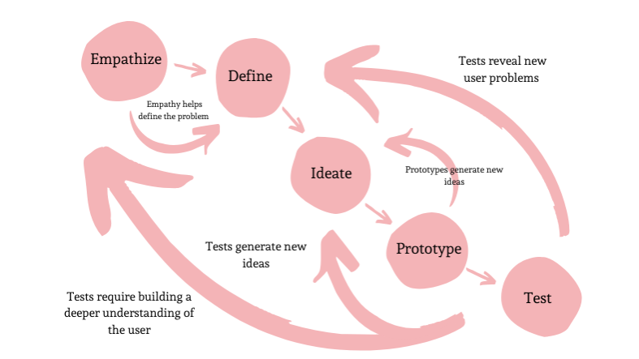
Summary

Slide 11
Design Thinking Tools
Beginner’s Mindset – Everyone has their own understanding, experiences and mindset. This forces us to think in certain ways. Assuming a beginner’s mindset enables us to set the biases aside and see the situation with fresh eyes.
What / How/ Why – It is a tool to delve deeper into the problem. Observe what the subjects are doing, how they are doing the tasks and the motivations and emotions behind the actions.
Extreme users – They give valuable insights into the work-arounds they may have implemented.

Slide 12
Design Thinking Tools
Journey mapping (or experience mapping) is an ethnographic research method that focuses on tracing the customer’s “journey” as he or she interacts with an organization while in the process of receiving a service, with special attention to emotional highs and lows. Experience mapping is used with the objective of identifying needs that customers are often unable to articulate.
Assumption testing focuses on identifying assumptions underlying the attractiveness of a new business idea and using available data to assess the likelihood that these assumptions will turn out to be true. These assumptions are then tested through thought experiments, followed by field experiments, which subject new concepts to four tests: value creation, execution, scalability, and defensibility.

Slide 13
Design Thinking Tools
Mind mapping is used to represent how ideas or other items are linked to a central idea and to each other. Mind maps are used to generate, visualize, structure, and classify ideas to look for patterns and insights that provide key design criteria.
Prototyping techniques allow us to make abstract new ideas tangible to potential partners and customers. These include storyboarding, user scenarios, experience journeys, and business concept illustrations — all of which encourage deep involvement by important stakeholders to provide feedback.

Slide 14
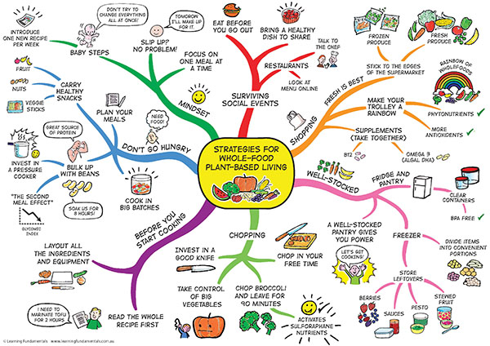
Example Mind-Map

Slide 15
Design Thinking Tools
Empathy Map - An empathy map is a widely-used visualization tool within the field of UX and HCI practice. In relation to empathetic design, the primary purpose of an empathy map is to bridge the understanding of the end user.
Both the process of making an empathy map and the finished artifact have important benefits for the organization:
Capture who a user or persona is. The empathy-mapping process helps distill and categorize your knowledge of the user into one place. It can be used to:
Categorize and make sense of qualitative research (research notes, survey answers, user-interview transcripts)
Discover gaps in your current knowledge and identify the types of research needed to address it. A sparse empathy map indicates that more research needs to be done.
Create personas by aligning and grouping empathy maps covering individual users
Communicate a user or persona to others: An empathy map is a quick, digestible way to illustrate user attitudes and behaviors. Once created, it should act as a source of truth throughout a project and protect it from bias or unfounded assumptions.

Slide 16
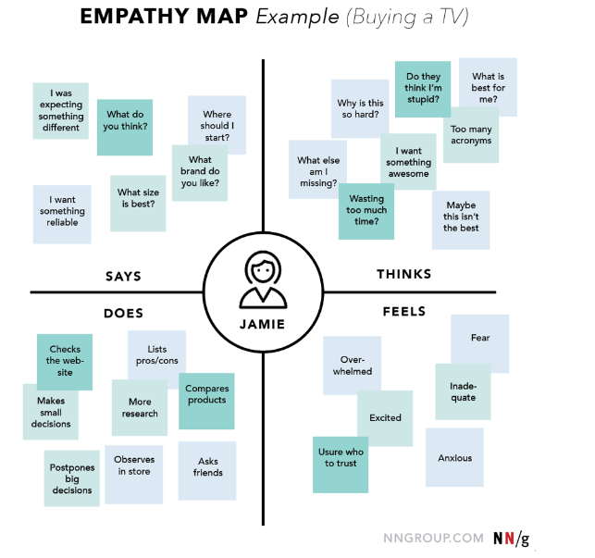
Design Thinking Tools

Slide 17
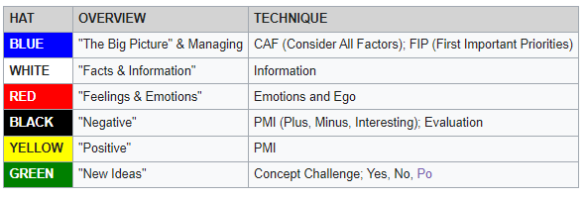
Six Thinking Hats

Slide 18
Po (lateral thinking)
The term po was created by Edward de Bono as part of a lateral thinking technique to suggest forward movement, that is, making a statement and seeing where it leads to.
It is an extraction from words such as hypothesis, suppose, possible and poetry, all of which indicate forward movement and contain the syllable "po."
Po can be taken to refer to any of the following: provoking operation, provocative operation or provocation operation.

Slide 19
Po (lateral thinking)
For example, in response to "sales are dropping off because our product is perceived as old fashioned":
po: Change the colour of the packaging
po: Flood the market with even older-looking products to make it seem more appealing
po: Call it retro
po: Sell it to old people
po: Sell it to young people as a gift for old people
po: Open a museum dedicated to it
po: Market it as a new product
Some of the above ideas may be impractical, not sensible or not business-minded. The value of these ideas is that they move thinking from a place where it is entrenched to a place where it can move.

Slide 20
Ideation
Warren Buffet says “Today’s successful companies live and die according to the quality of their ideas”
In the real world, one needs to generate a bunch of ideas and evaluate them in the underlying hope that some of them would have some business potential.
Creativity is thinking new things and innovation is in doing new things. Entrepreneurship is building a business around a new way of doing things.
One can be creative by thinking differently about existing problems and solutions.

Slide 21
Sources of Business Ideas
Past work experience
Hobbies and Interests
Strengths and Abilities
Friends and Family
Travel
Books and Magazines
Research Organizations e.g. CSIR
The web and the current trends

Slide 22
Idea Evaluation
The 3 step process helps evaluate ideas and focus on the best idea.
The steps of this process are:
Decision matrix analysis – helps analyze all the ideas and shortlist a few
Paired comparison – helps compare pairs of ideas to find the better one
5Qs exercise – final check to prioritize the ideas and arrive at the best one.

Slide 23
Decision Matrix Analysis
The decision matrix helps bring all the ideas into one place and lets you put down the factors that affect them.
The factors for business selection are:
Investment required
Ease of operations
Marketability
Fit with your strengths and interests
Product differentiation
Each factor has to be given a relative weight.
Assign a score to each idea-factor combination (scale: 0 to 5) and rank the ideas per the cumulative score.

Slide 24
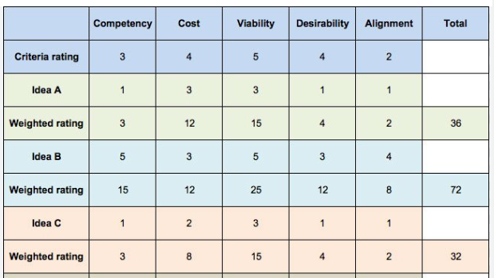
Sample DMA

Slide 25
Paired comparison analysis
This tool helps compare one idea with the other and evaluate which idea is better.
The comparison is based on the individual’s view of the potential of each idea.
The combined scores from the Decision Matrix Analysis and Paired Comparison Analysis will help decide which of the shortlisted ideas has the best potential.

Slide 26
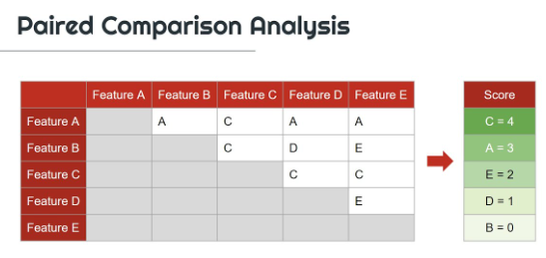
PCA Example

Slide 27
5Qs Exercise
The top few ideas can be put through this framework, which is based on 5 questions. The main questions help us group many more questions which address a wide range of concerns:
Which is the market segment being targeted?
What is the business model?
How big is the market?
How can you protect the business?
What are you getting out of it?

Slide 28
Identify the right problem

Slide 29
Finding problems to be solved
If you closely look at any long-lasting business, you'll realize that their core idea germinated from a core customer problem. A significant and market-relevant problem.
No surprise that Uri Levine, the founder of Waze, suggests, "Fall in love with the problem, not the solution."
Problem-solving involves finding innovative and creative solutions to address societal, technological, or business-related problems.

Slide 30
What defines a heart-felt problem?
Customer problems exist across multiple layers. There’s a surface layer where they tell you a solution they have in mind—like I want to save money making international calls. But at its core, all problems distill down to one or a few of these emotions:
Security
Attention
Control
Meaning & purpose
Privacy
Community
Intimacy
Status
Achievement

Slide 31
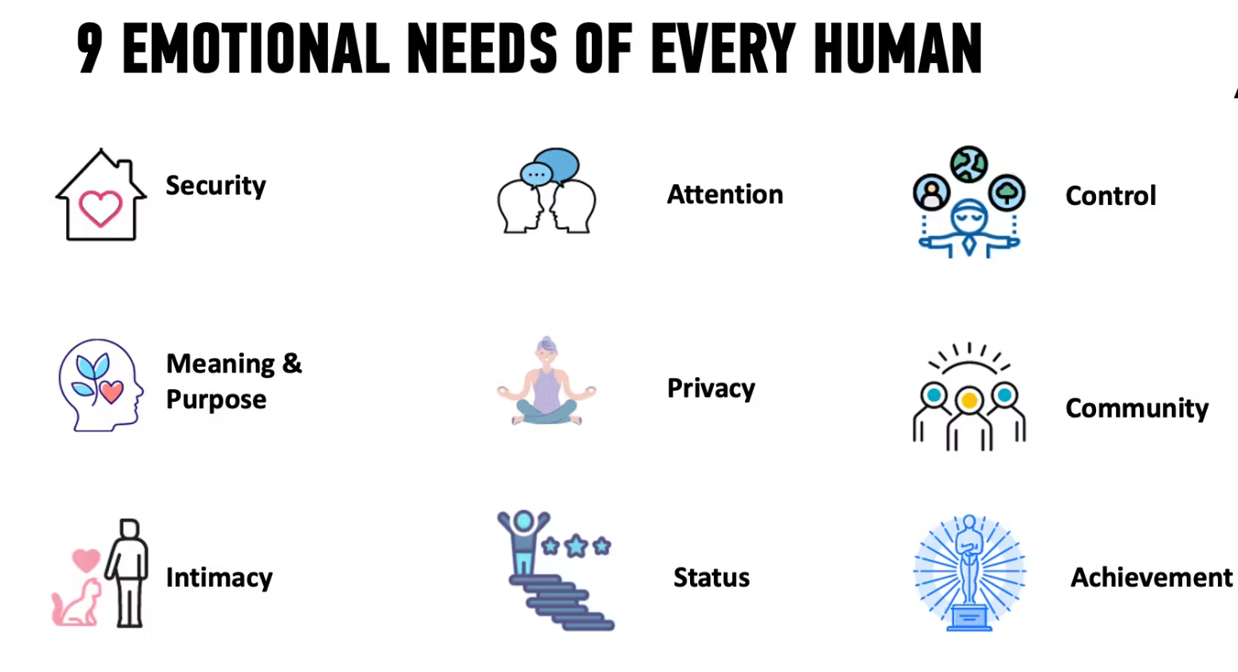
What defines a heart-felt problem?

Slide 32
What defines a heart-felt problem?
Great entrepreneurs look beyond the customer-suggested problems. They ask “5 why’s” until they get to the emotional reason that causes a customer to seek out a product.
Take the case of Slack, a workplace communication tool that has revolutionized how offices communicate.
Before Slack existed, office communication relied on email. Email was designed to be formal and disposable. However, Slack channels allowed teams with a shared interest to create more inclusive communication for everyone.
Suddenly, people working on the same project can create a project channel with a “searchable log of all communication and knowledge” (which is what SLACK stands for). What used to be an email thread now has a permanent space to foster a discussion around a common goal.

Slide 33
Five characteristics of heart-felt problems
Here are the five characteristics of heart-felt problems. The deeper the pain, the more value you can get from your customers:
Emotional — the problem must have an emotion attached to it
Functional — the problem must fulfill the basic functional need of the problem
Frequent — the problem must happen frequent enough for the user to justify the value
Urgent — the problem must have an impending deadline
Unavoidable — the problem must not have an easier way to get around the problem

Slide 34
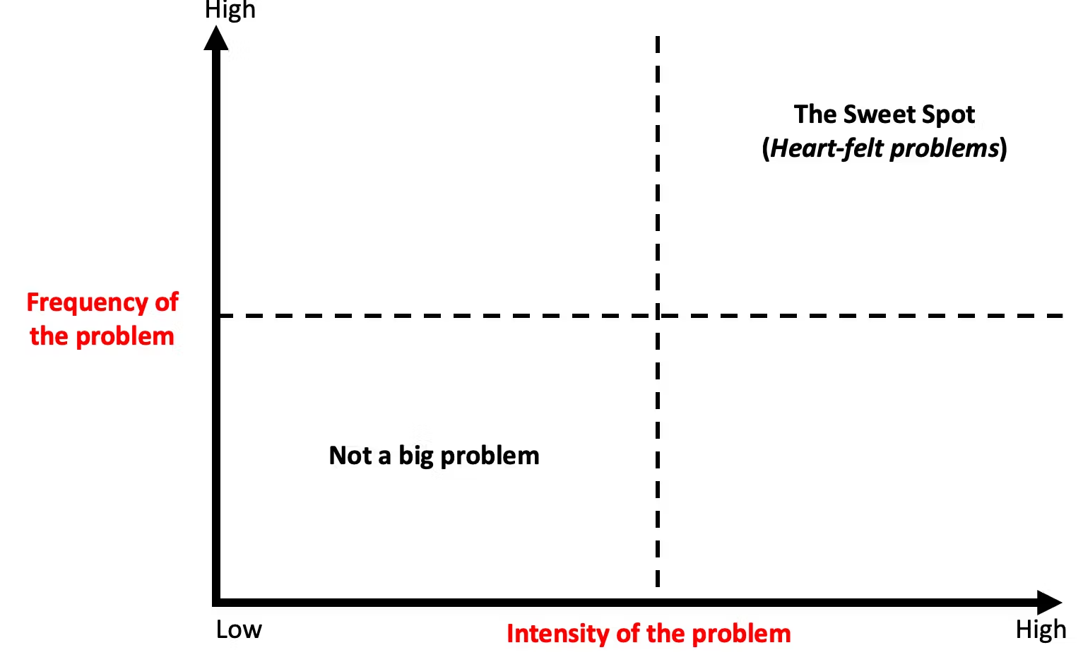
Heart-felt problems

Slide 35
Identify if a heart-felt problem is worth solving?
You’ll need to generate product ideas from market research and then identify customers' problems in that market to solve.
The first step is to research the market you want to be a part of. The opportunity size is based on how much your customer is spending to solve the problem right now. This information can come from industry research, government websites, and annual reports of key competitors, or you may even need to commission research if it’s too niche.

Slide 36
Identify if a heart-felt problem is worth solving?
You need to get out of your comfort zone and speak with your target customers. Put yourself in their shoes, and think about the problem you’re trying to solve.
Ask yourself: If this customer problem exists, where would your customers go to solve it?
Chances are there are existing communities or media channels that connect your potential customers. Go there.
And don’t be afraid to speak with your competitor’s customers to understand why they purchased the product and what problem it was solving for them.
There is no magic number of how many customer interviews you speak with. Start with five customers first, then adjust the questions every five customers until you have honed in on a deep enough problem with a large enough market size.

Slide 37
Identify if a heart-felt problem is worth solving?
The trick is to find a deep customer problem in a market that is large enough to sustain your vision. 99% of the worlds problems are not worth solving but if you persist, you’ll eventually find one.
Using the Jobs-To-Be-Done interview popularized by Clayton Christensen is an excellent method to speak with customers. Using the Jobs To Be Done framework is a blog post on its own.
Once you’ve found a heart-felt problem in a large enough market—the next step is to reframe the problem to look at it from varied perspectives. Doing so will help you make better decisions and arrive at radically better solutions.

Slide 38
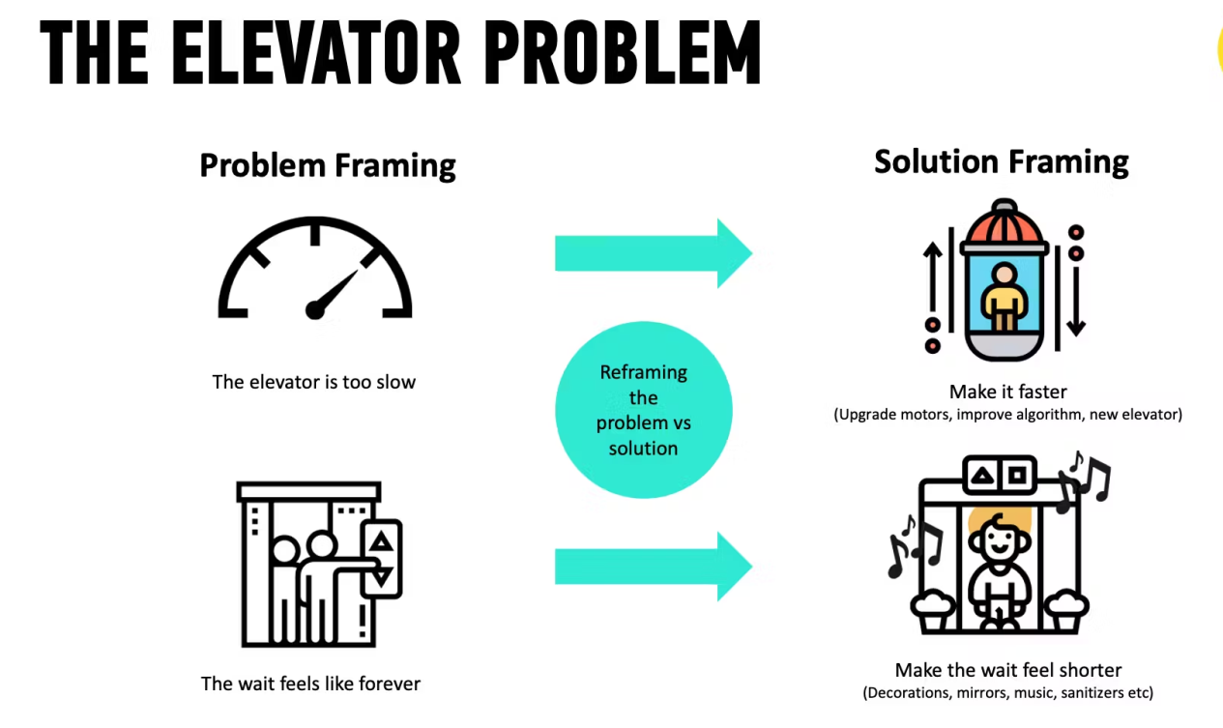
Example
Let's take the classic example of a slow elevator in a building. A heart-felt problem for tenants is “I feel like I’m wasting time” (an emotional problem that’s related to status, purpose and meaning).

Slide 39
GOOTB
According to Steve Blank in his acclaimed book, ”The Four Steps to the Epiphany”, the ideal approach is to embrace a culture of cultivating a frequent customer feedback loop throughout the product development cycle with the mindset that a bulk of the answers are out there — not in our designer minds, sticky notes or computers and will only remain latent until we engage customers.
Customer discovery which entails observing & interviewing customers seeks to discover their behaviors, motivations, and needs, expose problems and design opportunities, and find crucial information to drive design decisions.

Slide 40
Customer discovery which entails observing & interviewing customers seeks to discover their behaviors, motivations, and needs, expose problems and design opportunities, and find crucial information to drive design decisions.
GOOTB (Get out of the building) encourages an outside-in approach, a continuous customer feedback loop throughout the product development cycle. It religiously tilts away from the culture of building products with assumptions or pure logic.

Slide 41
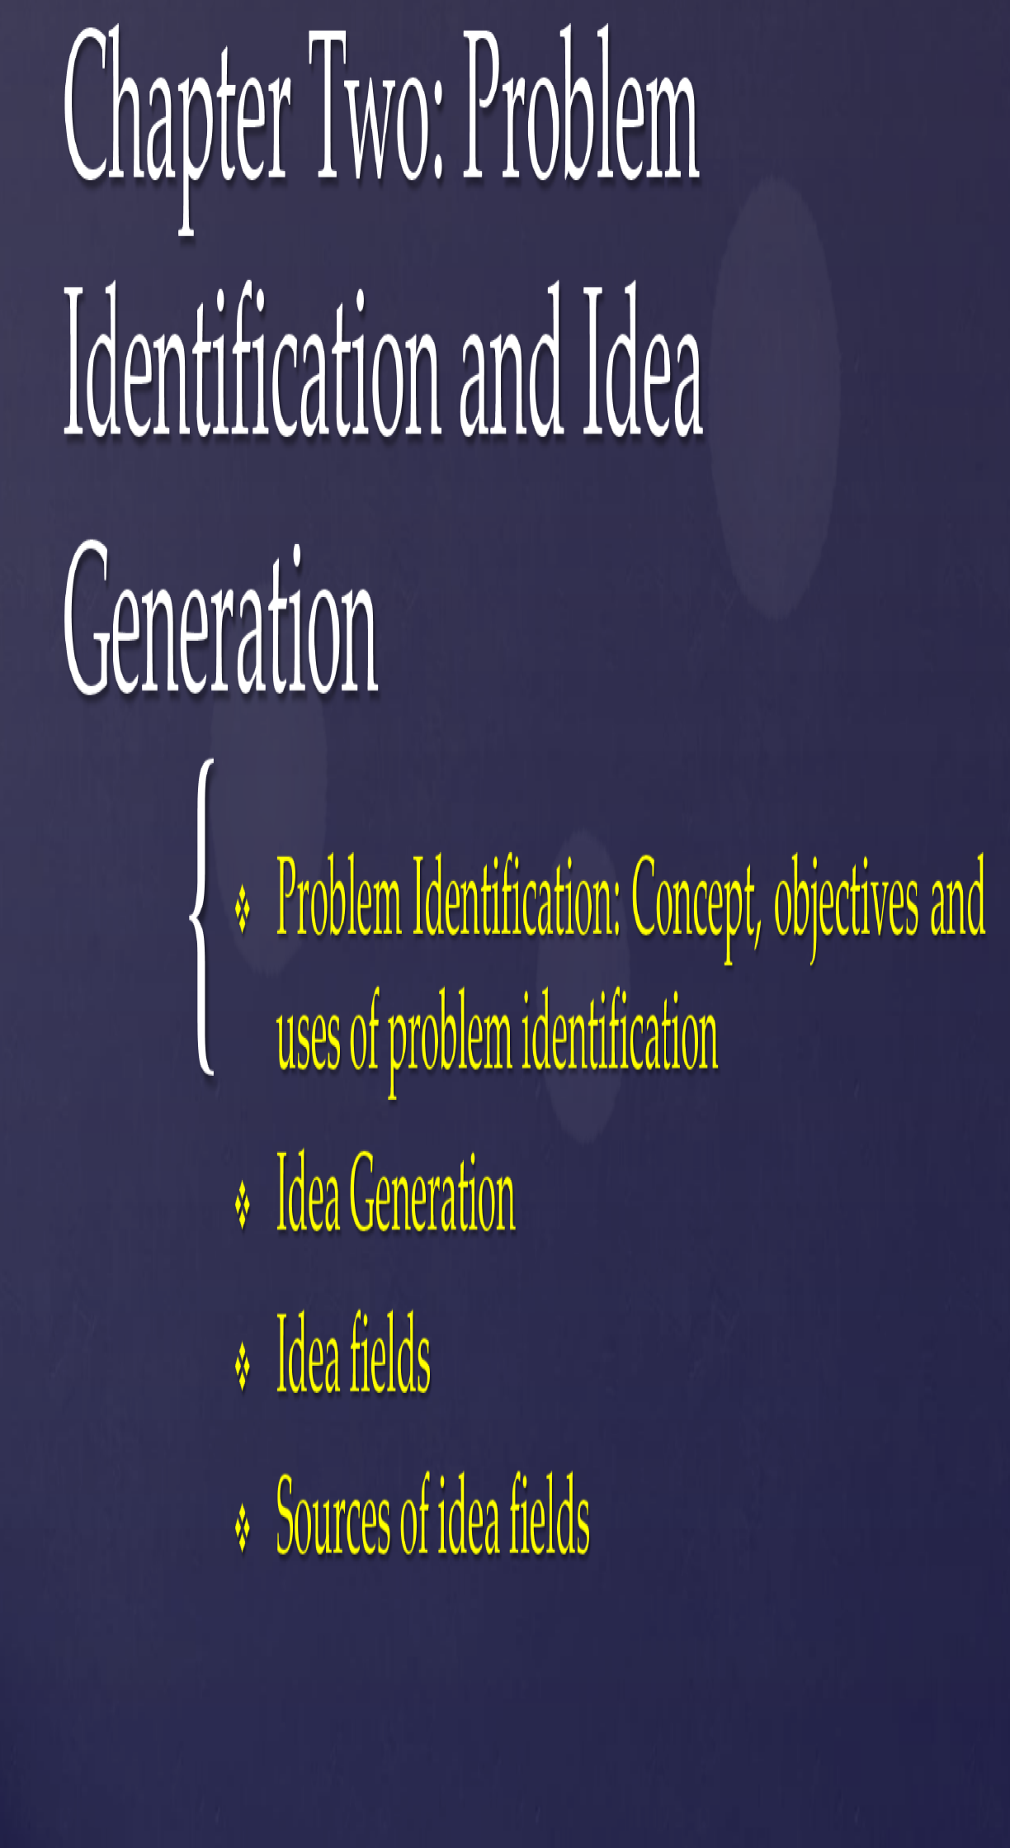

Slide 42
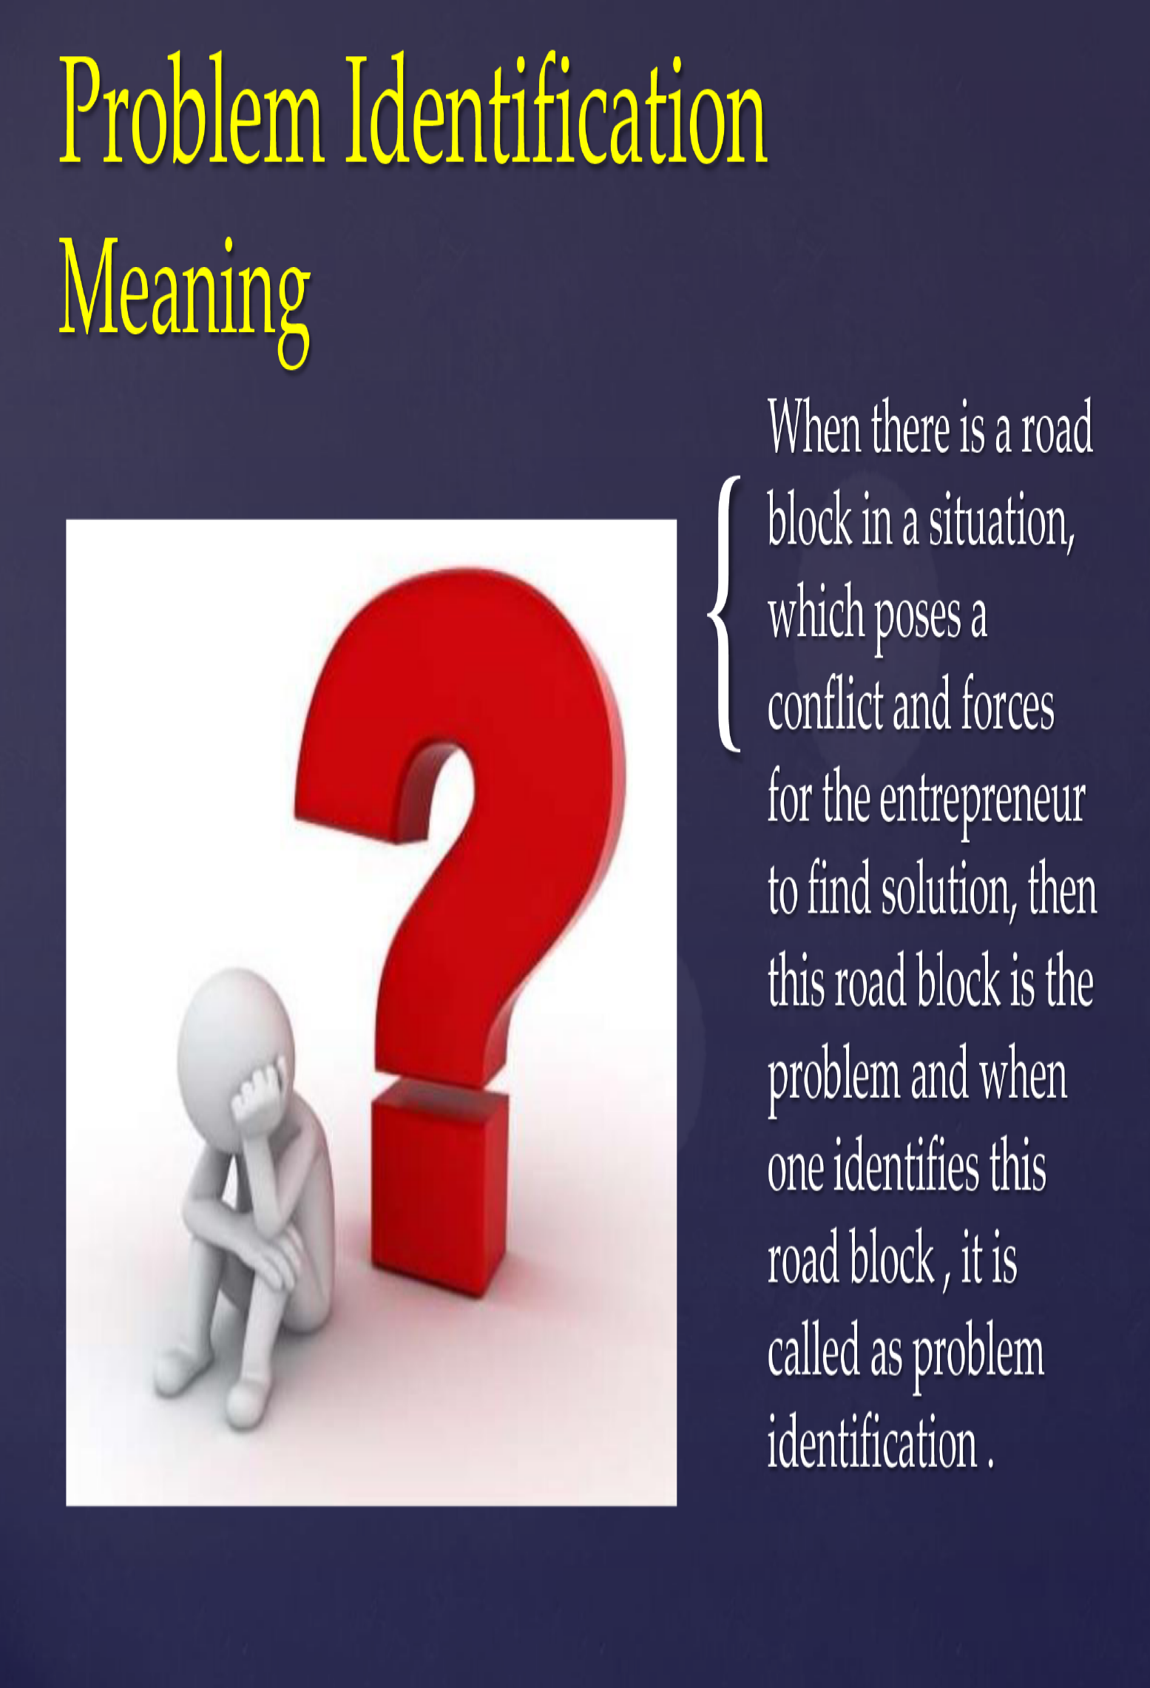

Slide 43
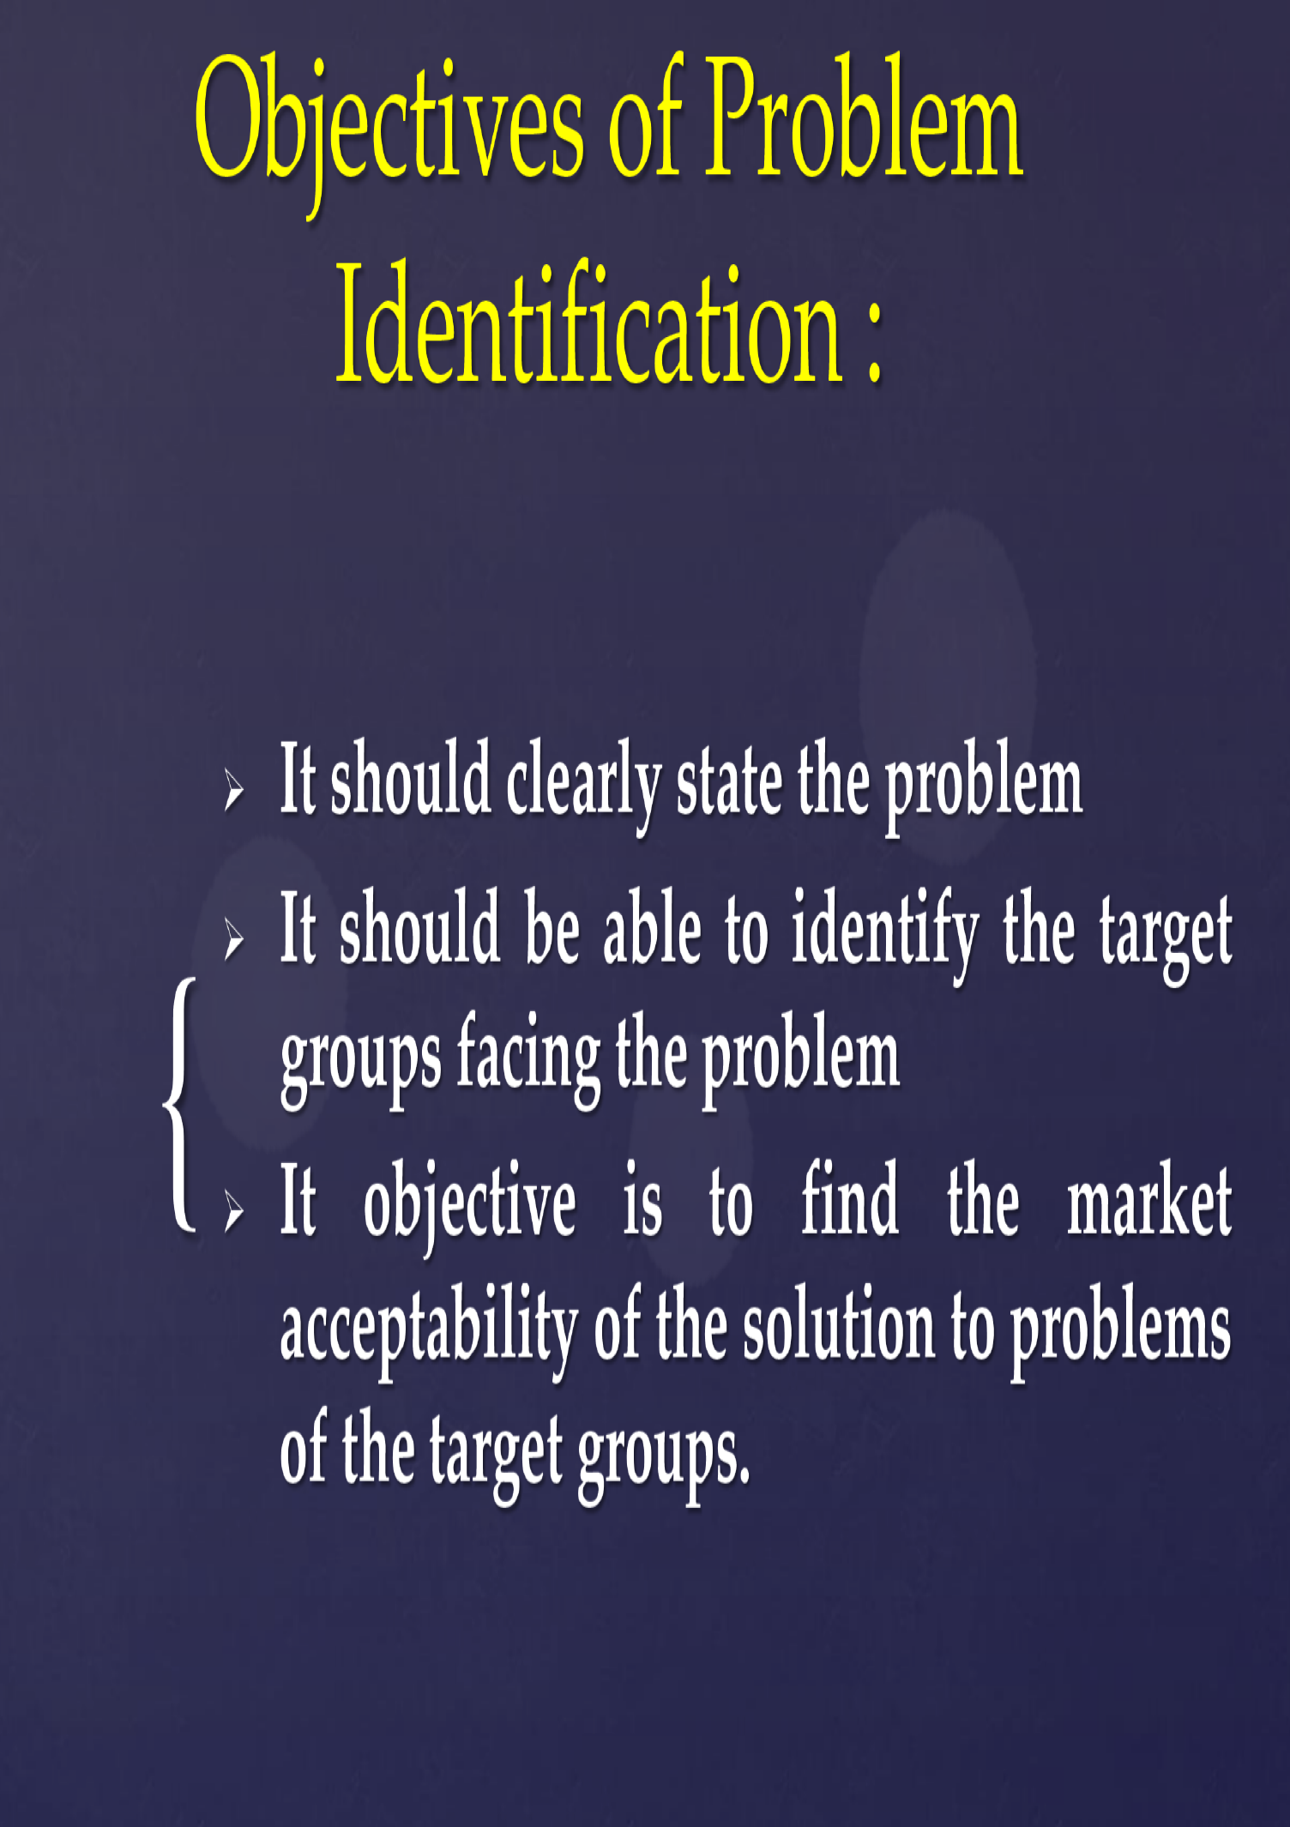

Slide 44
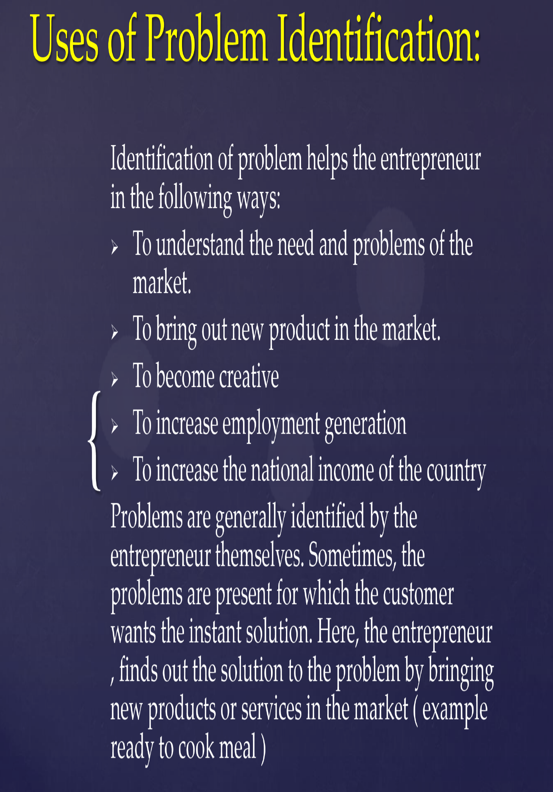

Slide 45
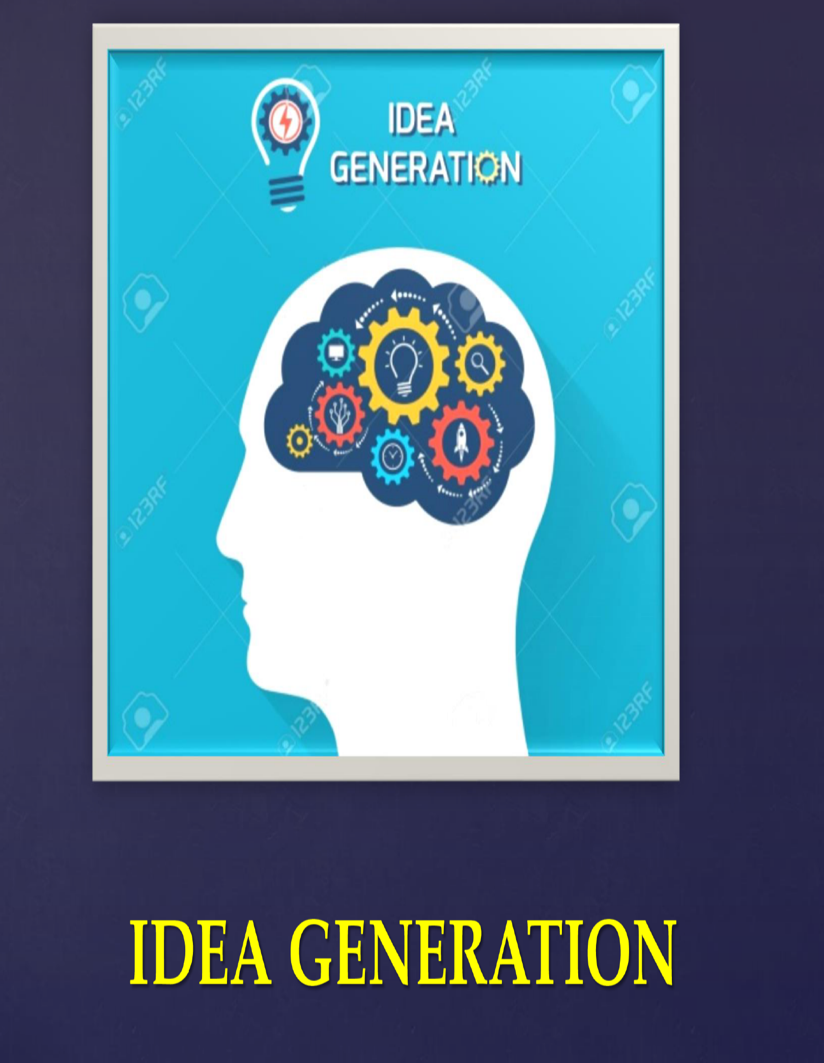

Slide 46
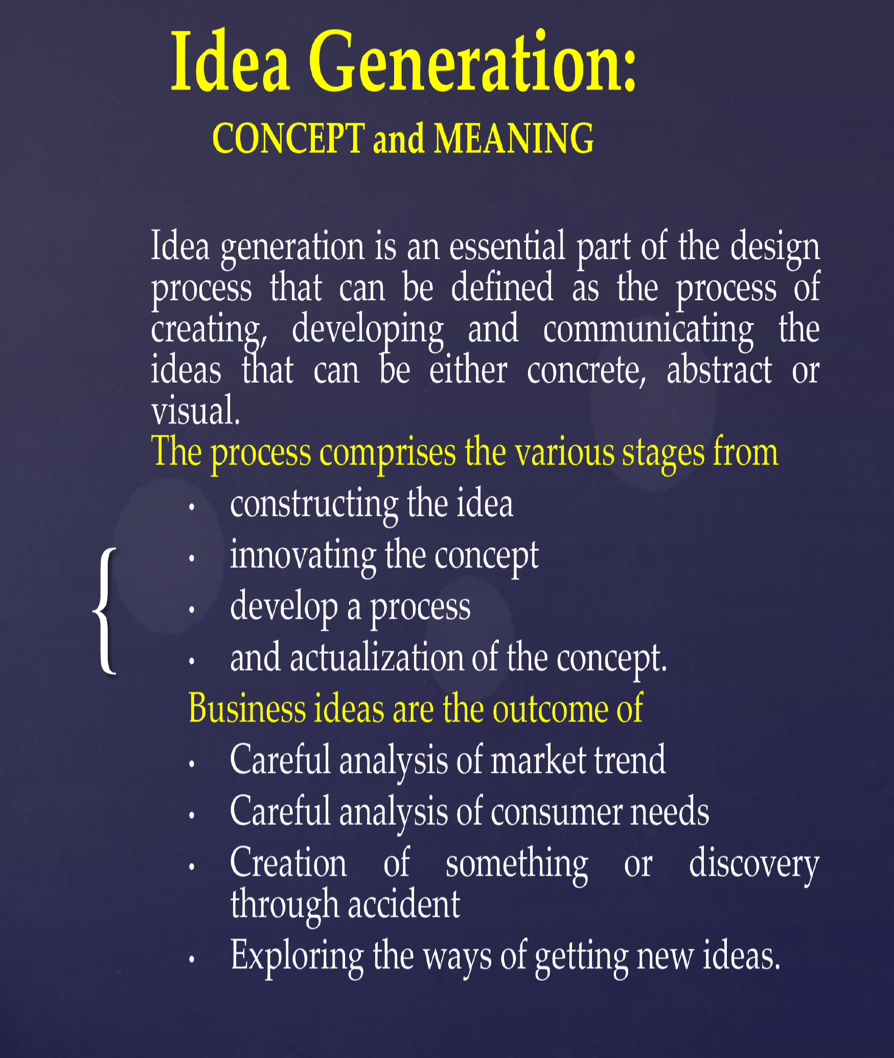

Slide 47
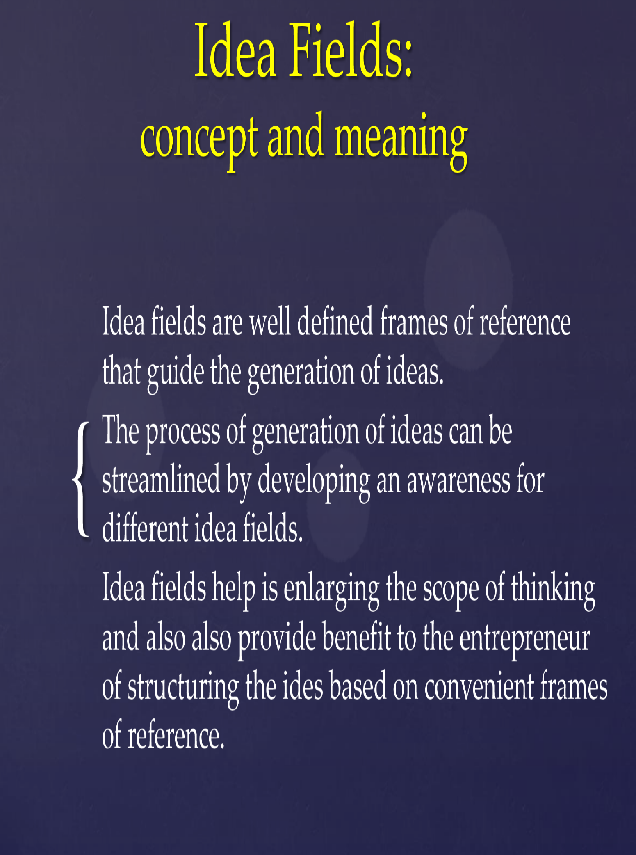

Slide 48
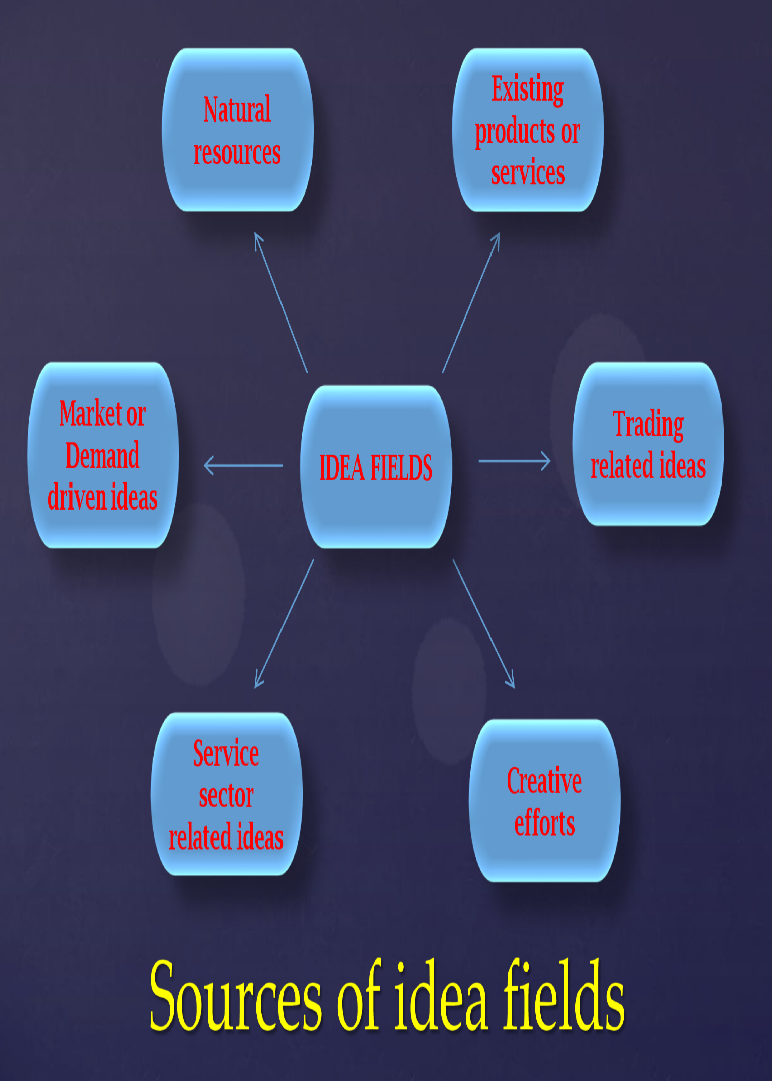

Slide 49
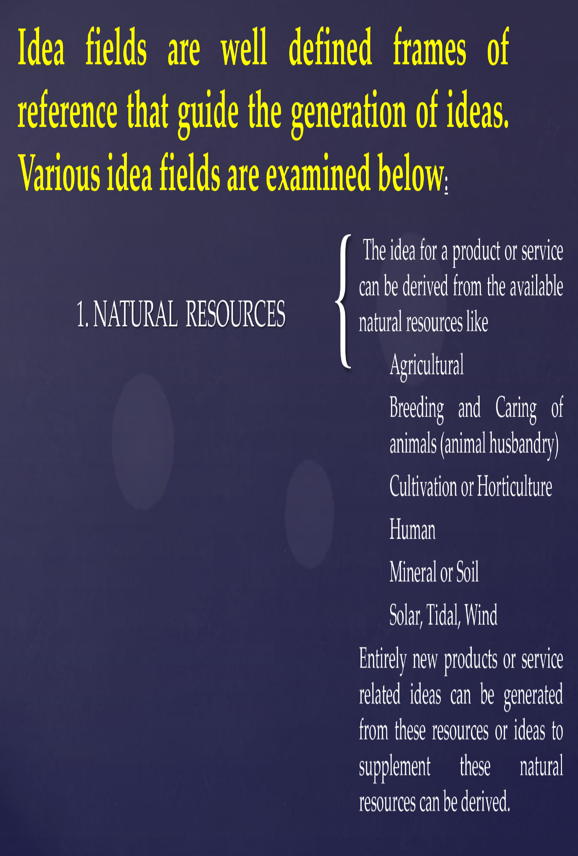

Slide 50
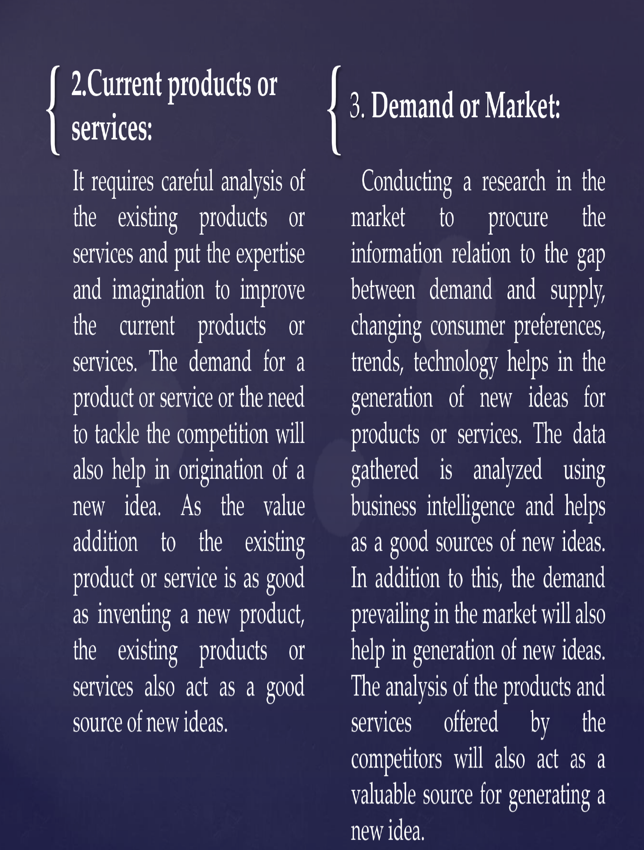

Slide 51
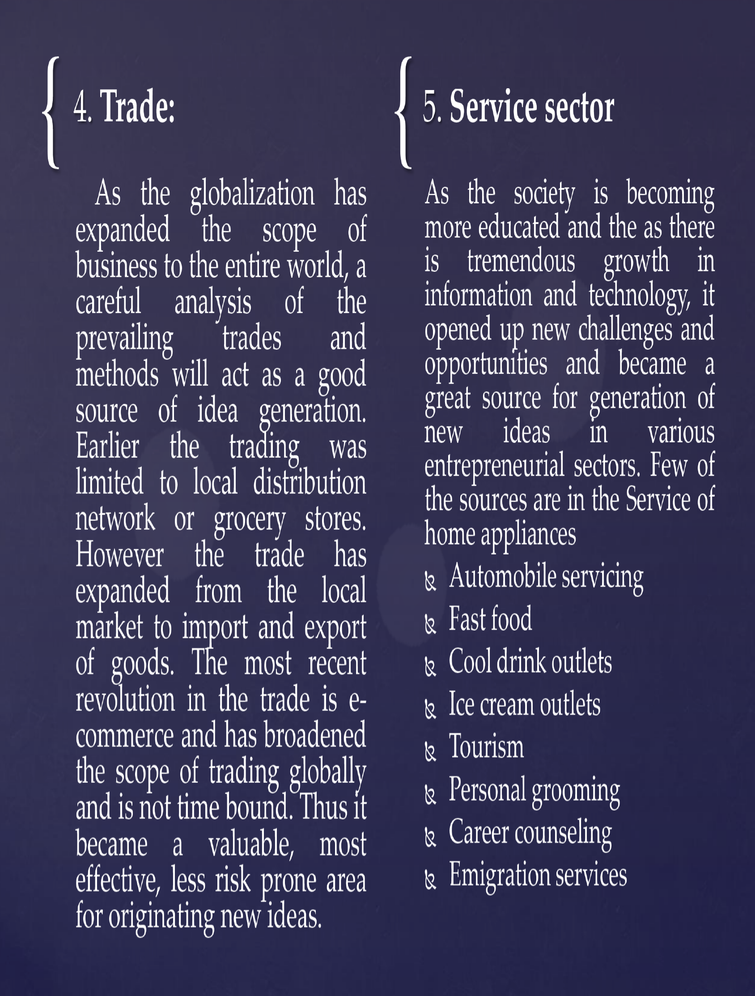

Slide 52
